Slide 1



Handsets Dashboard
View in Power BI
Last data refresh:
10/24/2023 6:44:44 PM UTC
Downloaded at:
10/24/2023 6:48:11 PM UTC

Slide 2
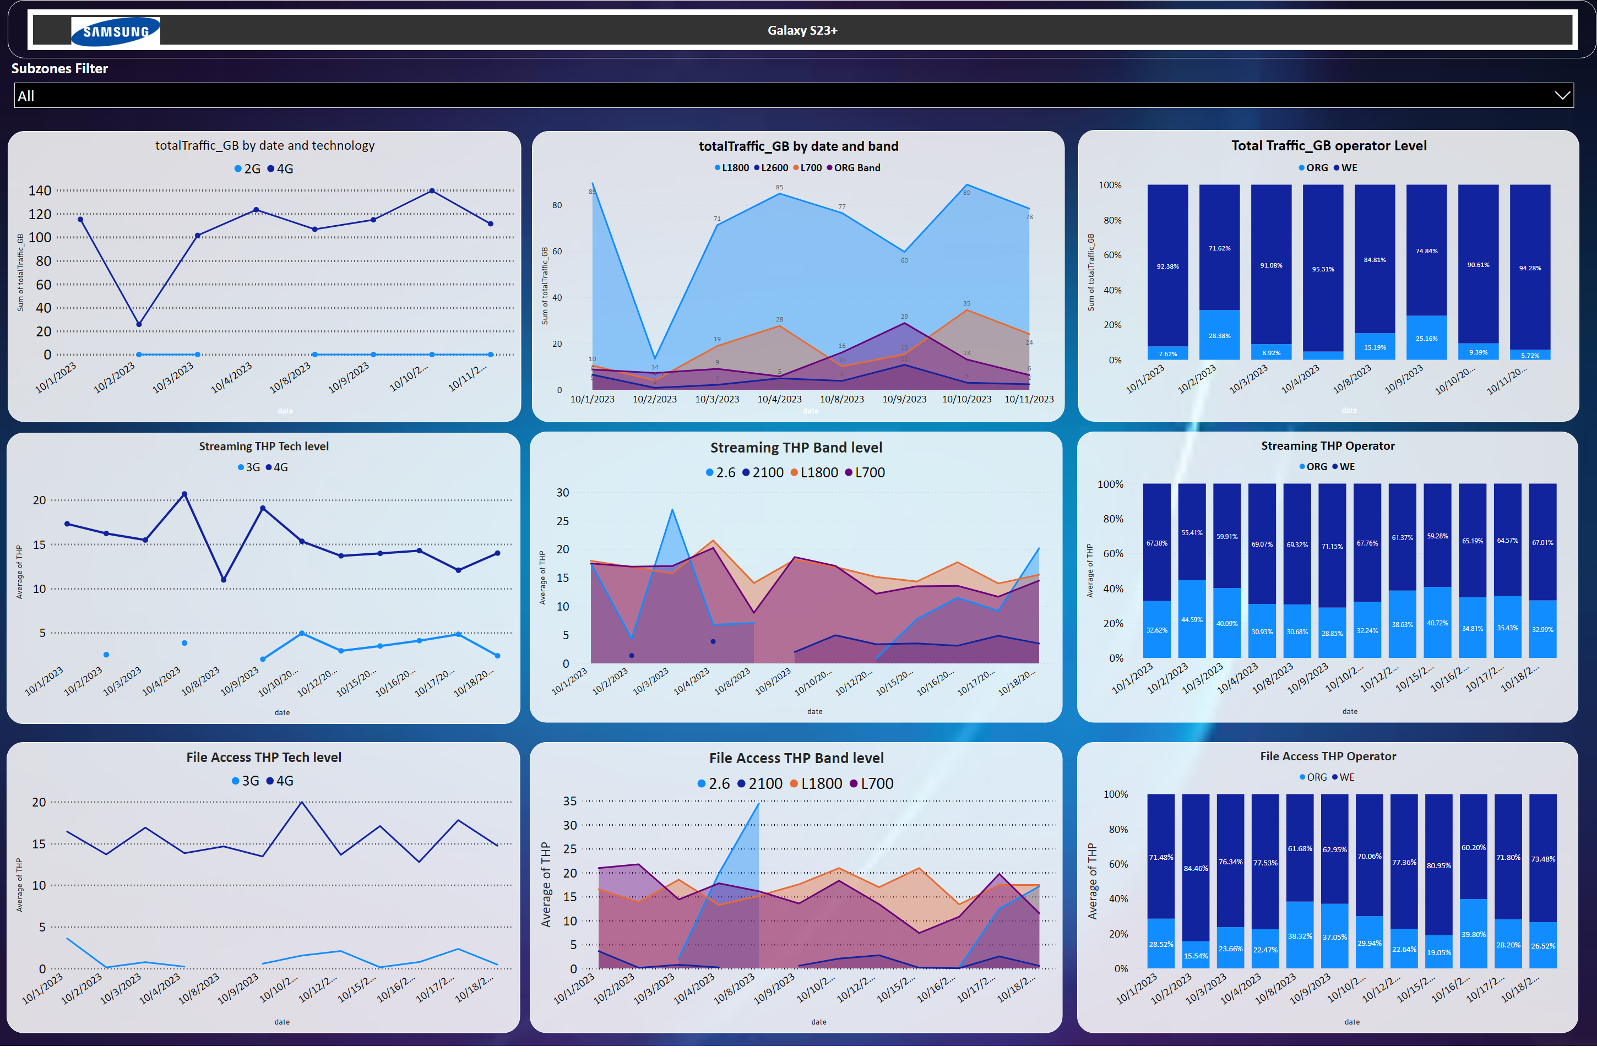
Galaxy S23
Notes:
slicer
No alt text provided
totalTraffic_GB by date and technology
No alt text provided
Total Traffic_GB operator Level
No alt text provided
totalTraffic_GB by date and band
No alt text provided
Streaming THP Tech level
No alt text provided
Streaming THP Band level
No alt text provided
Streaming THP Operator
No alt text provided
File Access THP Tech level
No alt text provided
File Access THP Band level
No alt text provided
File Access THP Operator
No alt text provided
slicer
No alt text provided
image
No alt text provided
Subzones Filter
No alt text provided

Slide 3
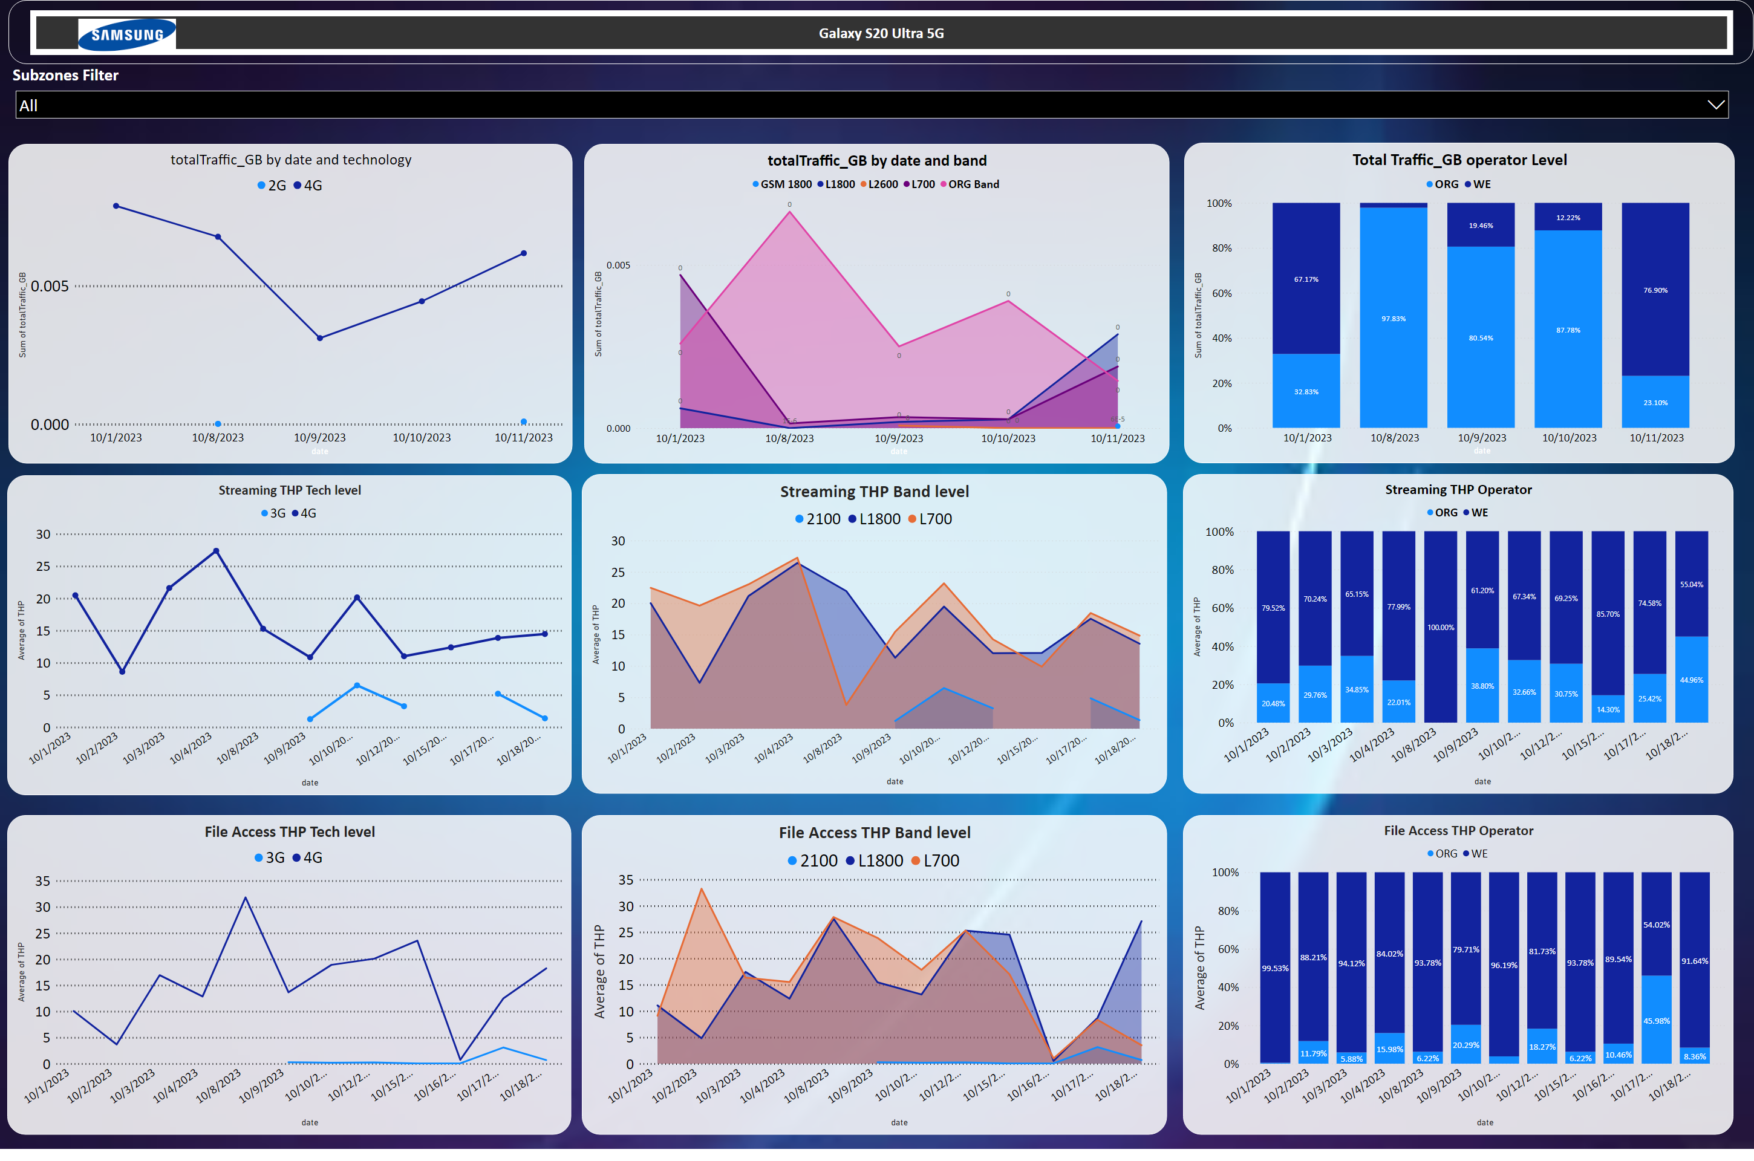
Galaxy S23
Notes:
slicer
No alt text provided
totalTraffic_GB by date and technology
No alt text provided
Total Traffic_GB operator Level
No alt text provided
totalTraffic_GB by date and band
No alt text provided
Streaming THP Tech level
No alt text provided
Streaming THP Band level
No alt text provided
Streaming THP Operator
No alt text provided
File Access THP Tech level
No alt text provided
File Access THP Band level
No alt text provided
File Access THP Operator
No alt text provided
slicer
No alt text provided
image
No alt text provided
Subzones Filter
No alt text provided

